Slide 1
Dystopian Societies

Slide 2
What is a Dystopia?
An imaginary society that has laws and rules that go are opposite of a utopian society, or an ideal and perfect world.
Totalitarianism=a political system where the government has complete authority over the citizens and seeks to control every aspect of their lives.

Slide 3
Characteristics of Dystopian Literature
Set in the future
There has been some conflict or war that has led to the dystopian society’s creation
Main character questions society and may attempt to bring it down
Story is usually unresolved, there is no resolution

Slide 4
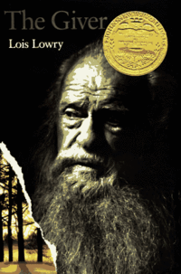
Ms. Miles’ Favorite Dystopian Examples:
http://www.youtube.com/watch?v=qoUT7q2iTbQ
http://www.youtube.com/watch?v=QH-6UImAP7c
http://www.youtube.com/watch?v=C8oiwnNlyE4

Slide 5
Assignment
Complete the following analogy with another dystopia:
_______in “Harrison Bergeron” is
to __________ in ____________.

